Slide 1


Interference Alignment By Motion
Swarun Kumar
Fadel Adib, Omid Aryan, Shyamnath Gollakota and Dina Katabi
Notes:
Hi, I am Swarun Kumar from MIT. I am going to talk to you about how to enable interference alignment by motion. This is joint work with my colleagues: Fadel, Omid, Shyam and Dina.

Slide 2
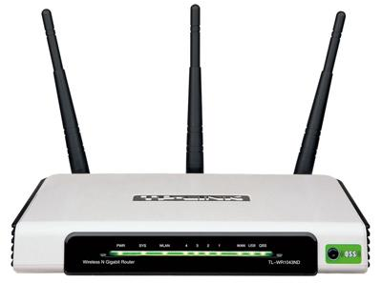
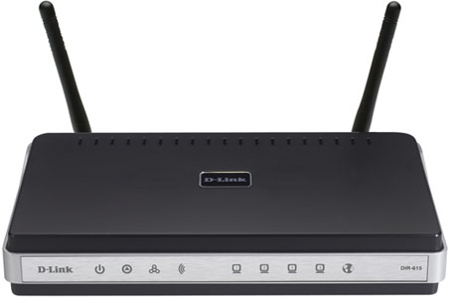



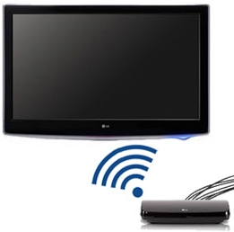

Major Advances in MIMO
E.g. Interference Alignment
Significant gains in throughput
Notes:
Recently, there’s been major advances in MIMO techniques.
These techniques, such as interference alignment, exploit the fact that many of our Wi-Fi devices today, such as our laptops, netbooks and TVs are MIMO-capable, that is they have multiple-antennas.
As a result, they experience significant gains in wireless network throughput.

Slide 3

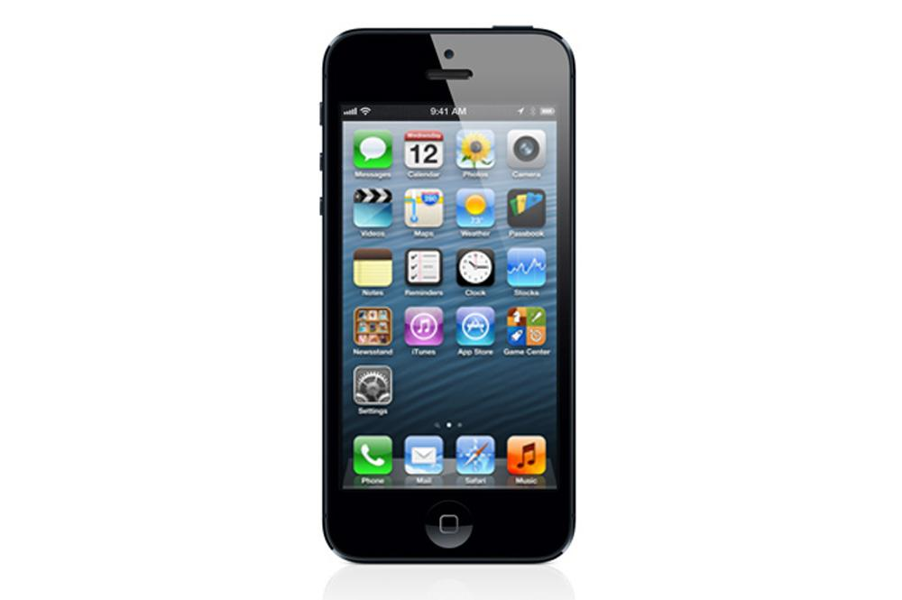
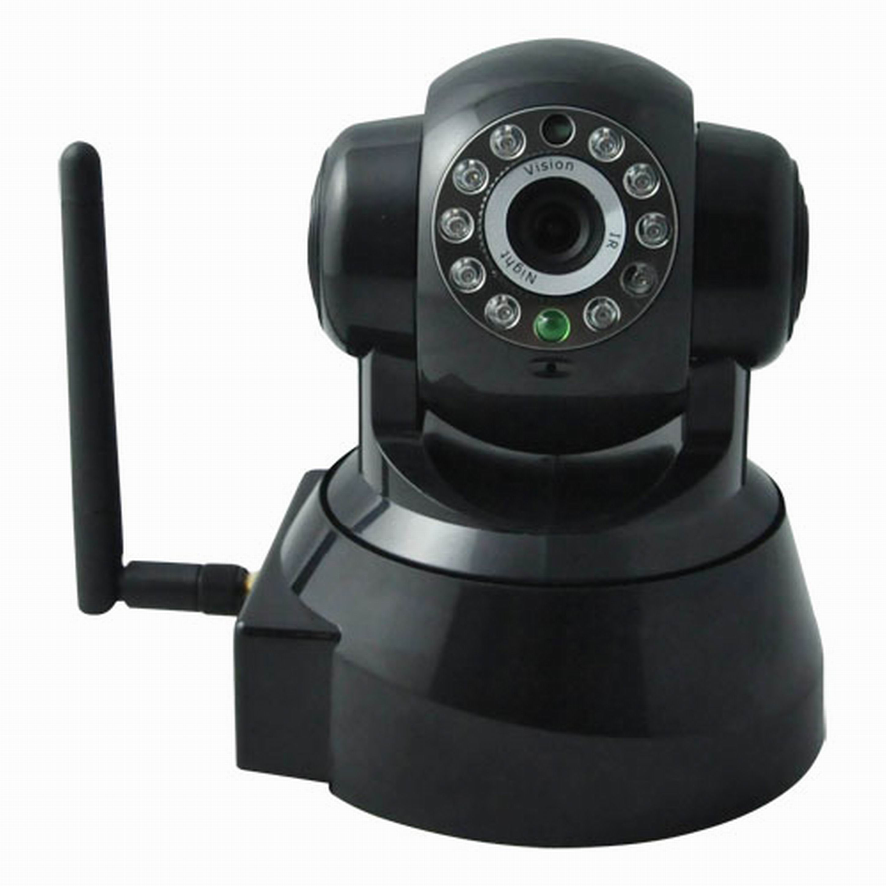
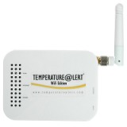
Single-Antenna Devices
Single Antennas, due to limits on power and size
Largely left out of these MIMO benefits
Notes:
But there continues to be a large class of our smaller devices which still have single antennas.
For example, the vast majority of cellphones today, when uploading a video over Wi-Fi still use only a single antenna.
So does a wireless web-cam sending a live video feed to your laptop.
And in sensor networks, small sensors cannot afford more than a single antenna to send its data to the base station.
Much of these devices are constrained to have single antennas due to limits on power and form factor.
As a result, they are largely left out of much of the benefits in throughput from these MIMO techniques.

Slide 4
Goal
Bring MIMO Benefits to Single Antenna Devices
“Interference Alignment”
Notes:
So our goal, in this talk, is to bring these MIMO benefits to single antenna devices.
In particular, we focus on one of the most general MIMO interference management techniques, called interference alignment.

Slide 5
Interference Alignment
2-antenna node can decode only 2 signals
antenna 2
C1
C3
C2
AP 1
antenna 1
1
2
interfere
interfere
C1
C2
C3
Notes:
Let me give you a quick primer on how interference alignment works.
Let’s say we have a 2-antenna client device uploading packets to a 2-antenna access point.
Since AP1 is a 2-antenna access point, it gets some part of this signals on antenna 1 and some on antenna 2.
So we can represent C1’s signal as 2-dimensional vector.
But suppose two neighboring clients C2 and C3 interfere with this transmission. Of course, their signals will now also appear in the 2-antenna space.
But recall from basic MIMO, that an 2-antenna wireless node can only decode up to 2 independent signals. So as AP1 receives 3 independent signals…

Slide 6

Interference Alignment
2-antenna node can decode only 2 signals
antenna 2
C1
C3
C2
AP 1
antenna 1
1
2
interfere
interfere
C1
C2
C3
Notes:
It cannot decode any of them!

Slide 7
Interference Alignment
2-antenna node can decode only 2 signals
antenna 2
C1
C3
C2
AP 1
antenna 1
1
2
interfere
interfere
C1
C2
C3
“align”
Notes:
To mitigate this client C3 can leverage its multiple antennas to perform “interference alignment”

Slide 8
Interference Alignment
2-antenna node can decode only 2 signals
antenna 2
C1
C2
AP 1
antenna 1
C3
1
2
interfere
interfere
C1
C2
C3
“align”
Notes:
Essentially, C3 can intelligently allocate signal power on each of its antennas so as to rotate its signal vector to be aligned along C2.

Slide 9

Interference Alignment
2-antenna node can decode only 2 signals
antenna 2
C1
one unwanted interferer
AP 1
antenna 1
1
2
interfere
interfere
C1
C2
C3
“align”
Notes:
In effect, AP1 now views both C2 and C3’s signal as that of a single unwanted interferer
Hence, it now receives only two independent signals, and can easily decode C1’s signal and discard the interference.

Slide 10
Single-Antenna Devices
Can we still perform interference alignment?
Signals from all
clients will change
antenna 2
C1
C3
C2
AP 1
antenna 1
1
2
interfere
interfere
C1
C2
C3
Notes:
But let’s say we now replace the clients by single-antenna devices instead of two-antenna ones. At this point, the clients can no longer perform MIMO.
So, can we still some how perform interference alignment?
… Here’s a hint: The AP here is still a MIMO device. So can we somehow perform alignment from the AP instead?
… Let me tell you how.
Let’s say we can slightly adjust the position of one of the AP’s antennas.
Of course, at the antenna’s new position the signals it receives from all three clients would have changed.

Slide 11
Single-Antenna Devices
Can we still perform interference alignment?
Signals from all
clients will change
C1
antenna 2
C2
AP 1
C3
antenna 1
1
2
interfere
interfere
Perform Interference Alignment purely at the AP
Eliminates feedback/cooperation with clients
Brings benefits of alignment to new devices
C1
C2
C3
Notes:
What if we can somehow move this antenna to a particular position where C2 and C3 just happen to align.
If this is possible, we’ve performed interference alignment purely at the access point, with no help from the clients.
This would effectively eliminate any feedback or cooperation between the AP and the clients.
Further, it would bring the benefits of alignment to a whole new class of devices, which are constrained to have single-antennas.

Slide 12
MoMIMO
Moves the AP’s antenna to positions that achieve interference alignment
Needs to only displace antenna by up to 2 inches
Achieves 1.98x gain in throughput over 802.11n
Notes:
In the rest of this talk, I will introduce MoMIMO, that shows that such positions of alignment indeed exist.
MoMIMO demonstrates that we can indeed move the AP’s antenna to these positions to perform interference alignment.
Surprisingly, we show that we only need to displace the antenna by up to two inches, for Wi-Fi signals at 2.4 GHz. This makes it practical for recent USB Wi-Fi adapters with sliding antennas, like the one in my hand.
MoMIMO achieves a 1.98x gain in throughput over 802.11 for both uplink and downlink traffic.

Slide 13
1. How do we “find” positions of alignment?
2. How does it impact general wireless networks?
Notes:
To understand how MoMIMO works, we need to answer two questions.
First, how does it find positions of alignment?
Second, how does it benefit general wireless networks?
Let me first focus on the first question: how do we find positions of alignment?

Slide 14
Feasibility of “Alignment by Motion”
Record antenna displacement for interference to drop below noise
1
2
AP 1
2 inch radius
desired
interfere
C1
C2
C3
Notes:
To answer this question: we first need to check if alignment by motion is even possible in the first place!
So we went ahead and built our system on a two antenna access point AP1 which receives packets from client C1. But AP1 suffers interference from two single antenna clients C2 and C3.
We then allowed the AP to move its second antenna within a radius of two inches, so as to align C2 and C3.
We then record how far should we displace this antenna for any interference to drop below the noise floor.

Slide 15
Feasibility of “Alignment by Motion”
Notes:
So we measured this quantity across multiple experiments and plotted the CDF.

Slide 16
Feasibility of “Alignment by Motion”
90th Percentile: 1 inch
Median: 0.3 inch
Why is the required displacement small?
Notes:
Here are the results. As you can see the median displacement is just 0.3 inches while the 90th percentile is just 1 inch.
The natural question is: why is the displacement so small?

Slide 17
A Simple Example
C1
AP 1
1
2
antenna 2
align
Reference
Reference
antenna 1
C1
Notes:
To answer this question, let’s start with a simple example. Let’s say we have a two antenna access point AP1 which receives a signal from a single antenna client C1.
Let’s say we wish to align C1 along a reference direction pointing along antenna 1.
Notice now that C1’s signal here has some non-zero component along antenna 2. But if we were to somehow reduce C1’s signal at antenna 2 to zero.

Slide 18
A Simple Example
AP 1
1
2
antenna 2
align
C1
Reference
Reference
0
antenna 1
C1
Goal: Minimize signal from C1 to antenna 2
Notes:
Then C1’s signal will collapse to the x-axis, that is, it will align with the reference.
In other words, our goal is to find some way to move C1’s antenna so that the signal on antenna 2 is minimized.

Slide 19
Indoor Environments Rich in Multipath
High signal @2
(poor alignment)
Paths combine constructively or destructively based on phase
AP 1
1
2
C1
Notes:
To do this, we leverage the fact that indoor environments are rich in multipath.
To see why this is important, let’s look at the case where there’s just one reflecting surface in the environment.
So the AP’s second antenna obtains two copies of the signal: one from the direct path and another from the reflected path.
From basic electromagnetics, we know that these paths can combine either constructively or destructively, depending on the relative phase of these signals.
Let’s suppose that these two paths interfered constructively, so the signal at the antenna 2 was high, meaning poor alignment.

Slide 20
Indoor Environments Rich in Multipath
Paths combine constructively or destructively based on phase
For Wi-Fi, 2” ≈ λ/2
AP 1
1
2
0°
λ
360°
C1
Paths differ
by extra 2”
Notes:
But let’s say that the antenna moves slightly, so that the reflected path travels an extra 2 inches compared to the direct path.
Recall that for WiFi at 2.4GHz, 2 inches is roughly the wavelength λ/2
But remember that whenever an electromagnetic wave travels a distance λ, its phase changes from 0 degrees to a full 360 degrees.

Slide 21

Indoor Environments Rich in Multipath
Small displacement suffices for alignment
Generalizes to many reflectors, any alignment
Low Signal @2
(good alignment)
Paths combine constructively or destructively based on phase
For Wi-Fi, 2” ≈ λ/2
In-phase paths now out-of-phase!
AP 1
1
2
λ
180°
0°
C1
2
Paths differ
by extra 2”
Notes:
So if it travels λ/2, it changes in phase from 0 degrees to a 180 degrees.
This means that by travelling an extra distance of λ/2, the reflected path which was earlier in phase is now completely out of phase with the direct path.
In other words, the paths now interfere destructively, resulting in a low signal strength on antenna 2, as desired for good alignment.
Hence, the example demonstrates that a small displacement, within a couple of inches, is sufficient for good alignment.
In the paper, we show how this concept readily generalizes to situations with many reflectors, and for alignment any direction.

Slide 22

How Can We Find Good Alignment?
We must quantify goodness of alignment
Goal: Find antenna location that minimizes interference
C1
antenna 2
Poor
C1
{
C2
interference
C2
{
Good
antenna 1
interference
C1
C2
interference ≈ 0
Notes:
Now that we know that positions of good alignment exist, how do we find them?
To do this, we first need to quantify the goodness of alignment.
So let’s consider the case where we want to align a client C2 along the direction of C1.
To quantify their alignment, we look along the direction that is orthogonal to C1.
And we measure the interference of C2’s signal projected along this direction.
If the alignment is poor, then C1 and C2 are nearly orthogonal.
Hence the value of interference is high.
In contrast, if the alignment is good, then C1 and C2 nearly point to the same direction.
Hence the interference along the orthogonal direction is nearly zero. \\
Thus, for good alignment, our goal is to find some location in the environment that minimizes this interference.

Slide 23
Naïve solution: Random walk
Does not work!
Simulated the spatial profile of interference
Ten reflectors placed in randomly chosen locations
Applied standard multipath models
Notes:
Of course, one naïve solution, is to simply move the antenna randomly, until we find locations with sufficiently low interference.
So we went ahead and implemented this solution, but found that unfortunately, it does not work.
To understand why this is the case, we performed a simulation to analyze power of interference across spatial locations.
In particular, we modeled an indoor environment with ten randomly placed reflectors.
We then applied standard multipath models to calculate the interference.

Slide 24
Naïve solution: Random walk
High interference
3
30
2
20
1
y (in)
Interference (dB)
0
10
-1
0
-2
-3
-10
-3
-2
-1
0
1
2
3
x (in)
Notes:
Here a representative plot of the spatial profile of interference.
The red regions in this graph indicate high interference.

Slide 25
Naïve solution: Random walk
Goal: Find blue spots
Low interference
3
30
2
20
1
y (in)
Interference (dB)
0
10
-1
0
-2
-3
-10
-3
-2
-1
0
1
2
3
x (in)
Notes:
… while the blue spots depict points of low interference.
So, in effect, our goal is to find these blue spots.

Slide 26
Naïve solution: Random walk
Goal: Find blue spots
Blue spots of low interference are small
→ Hard to stumble upon in a random walk
3
30
2
20
1
y (in)
Interference (dB)
0
10
-1
0
-2
-3
-10
-3
-2
-1
0
1
2
3
x (in)
Notes:
As you can see, these spots of low interference are fairly small, so it is difficult to stumble upon them very quickly in a random walk.

Slide 27
Key Observation: Interference is smooth
Wireless channels are continuous and smooth functions over space
3
30
2
20
1
y (in)
Interference (dB)
0
10
-1
0
-2
-3
-10
-3
-2
-1
0
1
2
3
x (in)
Notes:
But notice here that the interference appears to be a smooth function over space.
The reason for this is that the interference is derived from wireless channels, which are themselves, smooth and continuous over space.

Slide 28
Solution: A Hill Climbing Algorithm
Move in random direction and track interference
3
30
2
20
1
y (in)
Interference (dB)
0
10
-1
0
-2
-3
-10
-3
-2
-1
0
1
2
3
x (in)
Notes:
So the solution we adopt is to design a stochastic hill climbing algorithm.
Essentially the algorithm moves by picking an arbitrary direction and measuring how the interference changes along that direction.

Slide 29
Solution: A Hill Climbing Algorithm
Move in random direction and track interference
If interference ⬇ : continue in that direction
3
30
2
20
1
y (in)
Interference (dB)
0
10
-1
0
-2
-3
-10
-3
-2
-1
0
1
2
3
x (in)
Notes:
If I decreased, as desired, then we continue in that direction until the interference starts to increase again.

Slide 30
Solution: A Hill Climbing Algorithm
Move in random direction and track interference
If interference ⬇ : continue in that direction
3
30
2
20
1
y (in)
Interference (dB)
0
10
-1
0
-2
-3
-10
-3
-2
-1
0
1
2
3
x (in)
Notes:
At that point, we pick a new random direction and proceed along that direction.

Slide 31
Solution: A Hill Climbing Algorithm
Move in random direction and track interference
If interference ⬇ : continue in that direction
If interference ⬆ : continue in opposite direction
3
30
2
20
1
y (in)
Interference (dB)
0
10
-1
Algorithm converges to spot of minimum interference
Guides antenna to find positions of alignment
0
-2
-3
-10
-3
-2
-1
0
1
2
3
x (in)
Notes:
In this case, the new direction increases interference, so we backtrack along the opposite direction.
We repeat this algorithm multiple times, and found that it eventually converges to points of minimum interference.
Hence, MoMIMO can use this mechanism to guide an AP’s antenna to positions of alignment.

Slide 32
1. How do we “find” positions of alignment?
2. How does it impact general wireless networks?
Notes:
Now that we know how to find positions of alignment, let’s see how we can use this to impact general networks.

Slide 33
Interference Alignment
Align
C2 and C3
AP 1
AP 2
AP 3
C1
C2
C3
Notes:
To begin with, let’s say we have three single-antenna clients which want to transmit concurrently to their two antenna APs.
Of course, this would, for example, cause interference from C2 and C3’s signal at AP1.
To mitigate this, we apply MoMIMO’s algorithm so that C2 and C3 are aligned at AP1.
This way, AP1 can receive its signal from C1 interference-free.

Slide 34

Interference Alignment
Align
C1 and C3
AP 1
AP 2
AP 3
C1
C2
C3
Notes:
We perform a similar alignment at AP2

Slide 35
Interference Alignment
Align
C1 and C2
AP 1
AP 2
AP 3
C1
C2
C3
Notes:
.. And AP3..

Slide 36
Interference Alignment
AP 1
AP 2
AP 3
C1
C2
C3
3 concurrent streams → Gain in throughput!
N antenna APs enable N+1 concurrent uplink streams
Notes:
.. So that we ultimately have 3 concurrent streams, thereby providing a gain in throughput.
In the paper, we show that this can be readily generalized so that N antenna APs, each with one adjustable antenna can enable N+1 concurrent streams on the uplink.

Slide 37
What about downlink traffic?
AP 1
AP 2
AP 3
C1
C2
C3
Notes:
While this provides gains to uplink traffic, what about downlink packets from the APs to the clients?
Ideally, we want these downlink packets to also be sent concurrently from each AP to its corresponding client.
Unfortunately, these packets will now cause interference at the clients. For instance, here AP1’s packets interfere at both client C2 and C3.

Slide 38
What about downlink traffic?
AP 1
C2
C3
Notes:
So, let’s for the moment focus on AP1’s interference on the downlink to C2 and C3.

Slide 39
AP 1 has 2 antennas
2 antenna node can null interference at up to 1 antenna
C2 & C3 aligned
at AP 1
AP 1
null
??
C2
C3
Nothing!
Notes:
Remember that AP1 has two antennas.
And from basic MIMO, we know that a 2-antenna node can null interference at up to 1 antenna.
So let’s say AP1 nulls signals to client C2. Of course it does not have enough antennas to null at C3 as well. So, what does it need to do it null interference at C3?
Surprisingly, the answer is that it needs to do absolutely nothing!
To see why this is the case, recall that we had aligned C2 and C3 at AP1 on the uplink.

Slide 40
AP 1 has 2 antennas
2 antenna node can null interference at up to 1 antenna
C2 & C3 aligned
at AP 1
AP 1
null for free!
null
C2
C3
Notes:
This means that from AP1’s perspective, C2 and C3 appear to look like one client node.
So whenever AP1 nulls its signal at C2.
It also ends up nulling at C3 absolutely for free!

Slide 41
Uplink Wireless Channels
(h₁, h₂)
antenna 2
(h₃, h₄)
AP 1
antenna 1
h₁
h₄
h₂
h₃
C2
C3
h₁
h₂
h₃
h₄
=
Notes:
To more formally understand why this is the case, let’s look at the uplink wireless channels from clients to the access points.
Let h1 and h2 be the uplink wireless channels from C2 to the AP’s antennas.
So C2’s signal will lie along (h1, h2) in the antenna space of the AP.
Similarly, let h3 and h4 be the channels from C3 to the AP.
But remember that C2 and C3 were aligned at AP1 on the uplink, so (h3, h4) will lie in the same direction as (h1, h2). . Notice that from alignment, these two vectors have the exact same slope.
So we can write that h1/h2 is the same as h3/h4.

Slide 42
Downlink Wireless Channels
Channel Reciprocity
x
αx
null
AP 1
h₁
h₄
h₂
h₃
C2
C3
h₁x + h₂αx
Notes:
But let’s suppose we now flip the direction of transmission and look at the channels on the downlink.
Interestingly, the channels on the downlink are the same. This follows from reciprocity, which states that channels on the downlink are the same as channels on the uplink.
Let’s say AP1 decided to null its signal to C2. To do this, it leverages a concept called “MIMO precoding”.
Essentially, AP1 transmits a signal x on the first antenna, and sends the same signal x, but multiplied by some constant alpha on the second antenna. So the received signal will be h₁x + h₂αx.

Slide 43
Downlink Wireless Channels
Channel Reciprocity
x
αx
null
AP 1
h₁
h₄
h₂
h₃
C2
C3
h₁x + h₂αx = 0
Notes:
It then picks this constant alpha so that the signal received at C2 h₁x + h₂αx = 0 is zero, that is, any interference at C2 has been nulled.

Slide 44
Downlink Wireless Channels
Alignment on the uplink enables nulling on the downlink, with no extra movement
Channel Reciprocity
x
αx
null
AP 1
null
h₁
h₄
h₂
h₃
C2
C3
-h₁
h₂
h₁
h₂
h₃
h₄
-h₃
h₄
α =
α =
=
Notes:
And after some very simple math, this means for nulling, alpha must be equal to –h1/h2
But remember that our equation for alignment was h1/h2 = h3/h4.
In other words, alpha must also be equal to –h3/h4
This means that it obeys the precise condition for AP1 to null at C3 as well. So by nulling at C2, we also observe nulling at C3, with completely for free.
Hence, alignment on the uplink enables nulling on the downlink, with no extra movement necessary.

Slide 45
Downlink Traffic
AP 1
AP 2
AP 3
C1
C2
C3
Notes:
Thus, AP1 can now transmit its signal to client C1 without causing any interference at C2 and C3.

Slide 46
Downlink Traffic
AP 1
AP 2
AP 3
C1
C2
C3
Notes:
We can repeat this process at AP2

Slide 47
Downlink Traffic
AP 1
AP 2
AP 3
C1
C2
C3
Notes:
… and AP3

Slide 48
Downlink Traffic
AP 1
AP 2
AP 3
C1
C2
C3
3 concurrent streams on the downlink
MoMIMO provides gains to uplink & downlink traffic
Notes:
… so that we can ultimately send packets concurrently on the downlink.
Thus, MoMIMO provides throughput gains to both uplink and downlink traffic.

Slide 49
Experimental Results
Notes:
Now that we understand how MoMIMO works, lets see how it performs in practice.

Slide 50
MoMIMO Implementation
Implemented on USRP N210
Mounted antenna on Roomba to emulate sliding antennas
Compare MoMIMO with 802.11n, n+
Notes:
We implemented MoMIMO on USRP software radios.
We mounted the AP’s antenna on a roomba robot to emulate sliding antennas.
We then compare MoMIMO with standard 802.11n as well as n+, a recently proposed system which provides a state-of-the-art implementation of traditional interference alignment.

Slide 51
Testbed
Randomly assign nodes to red locations
Office Space
Class Room
Notes:
We conducted our experiments in two different buildings: an office building and a classroom complex. We assigned the nodes randomly to the red locations as shown.

Slide 52
Can Alignment Reduce Interference?
CDF
Interference (dB)
Notes:
We first investigate whether alignment by motion can sufficiently reduce interference.
So we measured the interference in dB, relative to noise across multiple experiments and plot the CDF.

Slide 53
Can Alignment Reduce Interference?
Median: -2.5dB
CDF
802.11n
MoMIMO
Downlink
Interference (dB)
Notes:
Let’s look at the results for 802.11 and MoMIMO.
As you can see the interference after applying MoMIMO drops significantly, with a median of -2.5 dB, which is below the noise floor.
Further we also notice that, by reciprocity, the interference on the downlink significantly reduced.

Slide 54
Throughput
Heterogeneous mix of 1 & 2-antenna nodes
CDF
Network Throughput (Mbps)
Notes:
Next we investigate how this translates into throughput gains.
In particular, we consider a heterogeneous mix of single and two antenna nodes.
We then measure the network throughput across experiments and plot the CDF.

Slide 55
Throughput
Heterogeneous mix of 1 & 2-antenna nodes
CDF
1.98x
802.11n
MoMIMO
Network Throughput (Mbps)
Notes:
Let’s first look at the results for 802.11 and MoMIMO.
As you can see the throughput gain of MoMIMO is 1.98x compared to 802.11

Slide 56
Throughput
Heterogeneous mix of 1 & 2-antenna nodes
CDF
1.31x
802.11n
MoMIMO
n+
Network Throughput (Mbps)
Notes:
Further, even if we apply standard interference alignment using n+…
.. We observe that our throughput gains are still 1.31x compared to n+.

Slide 57
Conclusion
Performs Interference Alignment purely by moving an antenna of the AP
Displaces antenna by up to 2 inches
New applications at intersection of networking and robotics
Notes:
To conclude.
I presented MoMIMO, which performs interference alignment purely by moving an antenna of the access point.
MoMIMO achieves its gains, while requiring to displace the AP’s antenna by up to 2 inches.
We envision that MoMIMO will open up new applications at the intersection of networking and robotics, where mobility is already innate.
Thank you and I will now take any questions.

